Slide 1
Arduino for Robots
Seminars at RSSC.org
Sergei Grichine
slg@quakemap.com

Slide 2
Agenda
Why Arduino
Common boards – Uno, Mega, Mini, Leonardo and just a chip
Precautions – power, loads
Tools – IDE, logic analyzer, USB/Serial,
Arduino in Robot Architecture
Code:
Highlights of functions
Making a library
Using interrupts to read encoders
Driving a motor via an H-Bridge
Multitasking
Serial communication to a PC
I2C communication

Slide 3
Why Arduino
Well designed cheap hardware
Insanely simple programming at the beginning
Friendly IDE – “keep it simple-stupid!”
Exceptional documentation
Community support, samples, forums, experts
Have a question? Just google it!

Slide 4
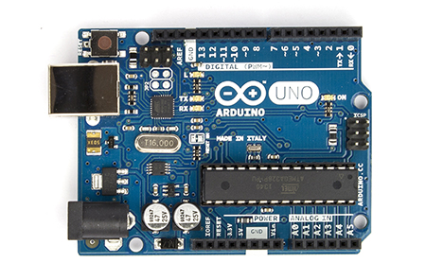
Common boards: Uno

Slide 5
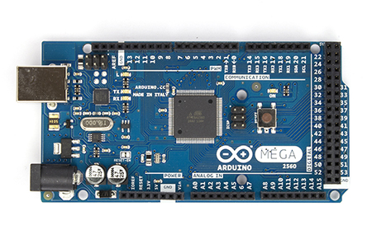
Common boards: Mega 2560

Slide 6
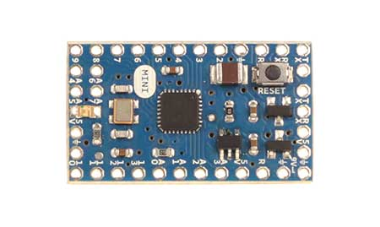
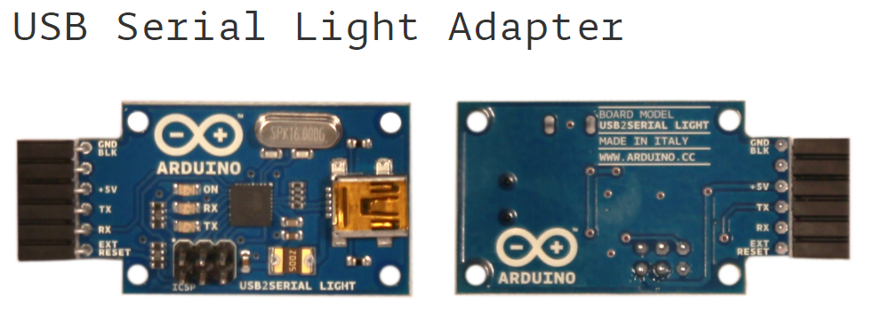
Common boards: Mini v05

Slide 7
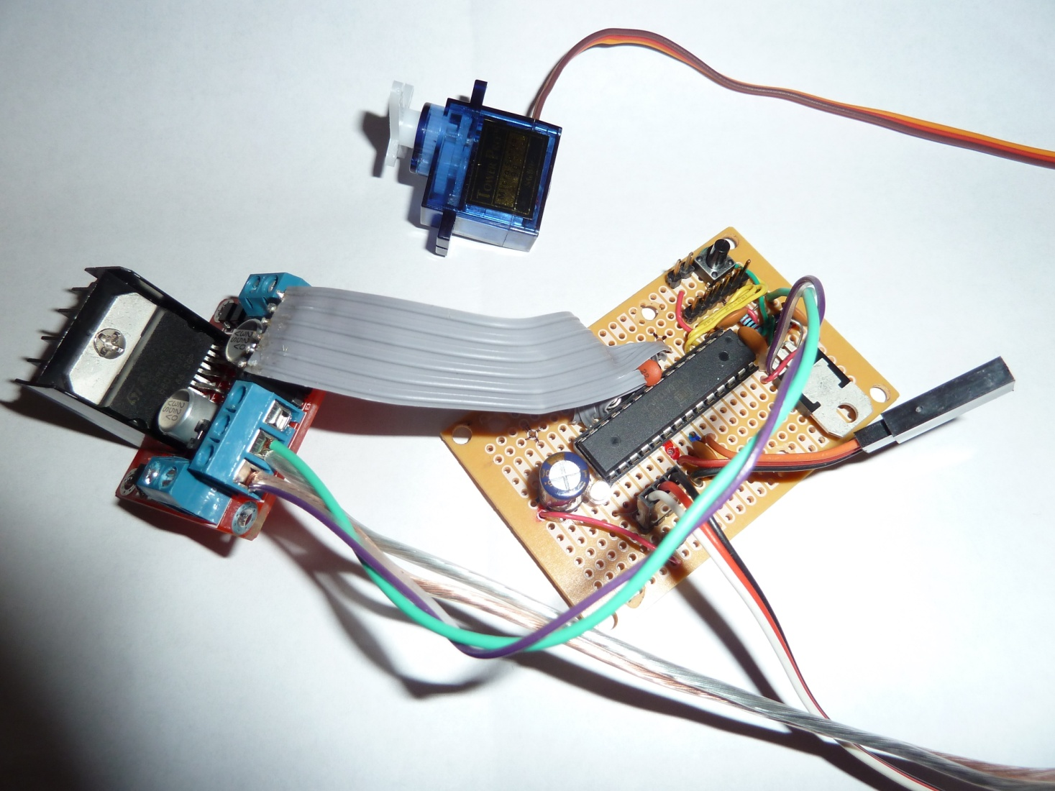
A no-board solution – just an ATmega328 chip

Slide 8
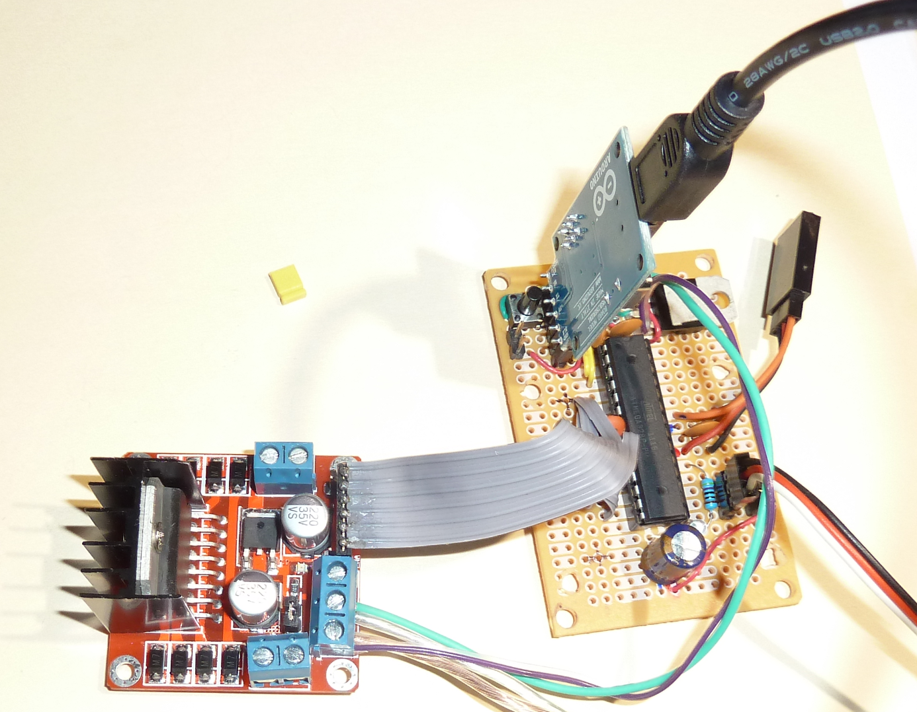

Slide 9
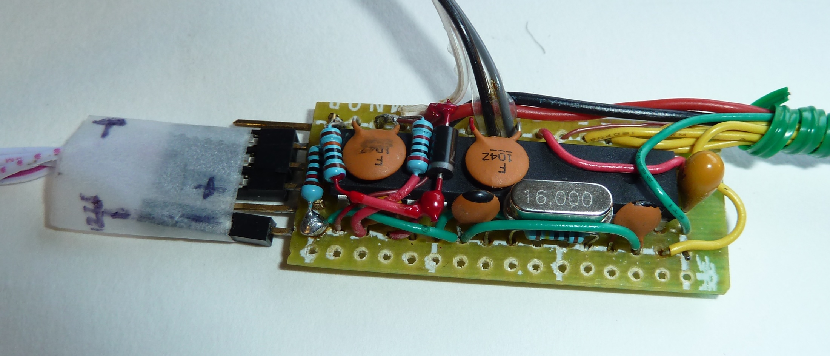

Slide 10
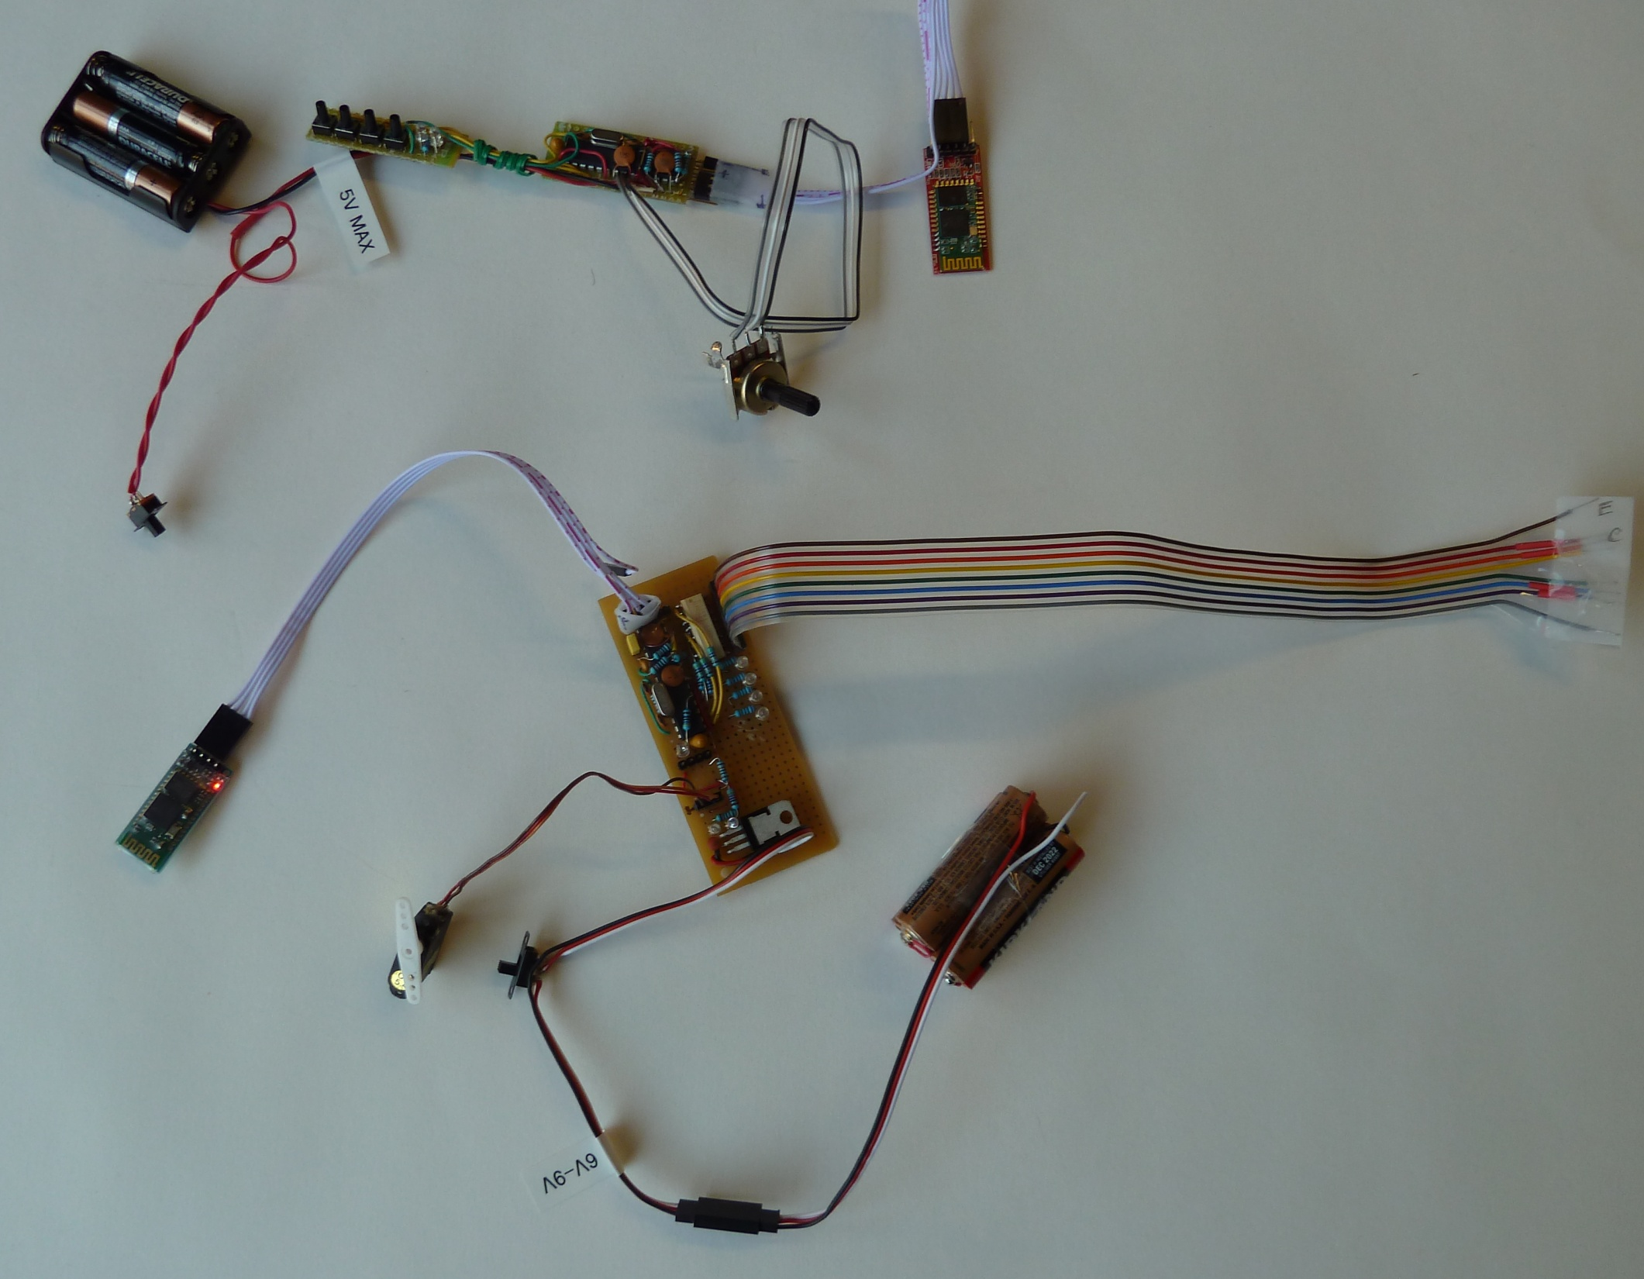

Slide 11
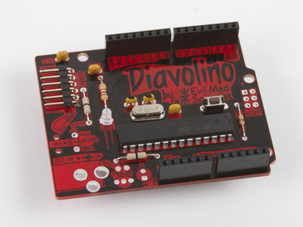
Diavolino - also just-a-chip

Slide 12
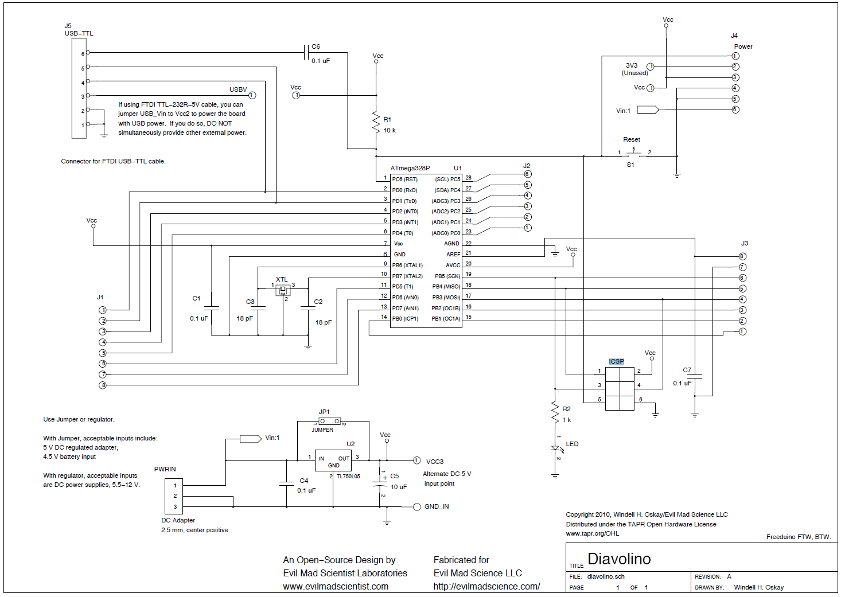

Slide 13
Precautions – power, loads
Vin: UNO – 7 to 10V Mega – maybe to 12V
2.1mm power plug (Fry’s has it)
the plug must be "centre positive", that is, the middle pin of the plug has to be the + connection.
250ma or more rated power adapter
Direct feed – 5V stabilized - can’t be used when Vin connected

Slide 14
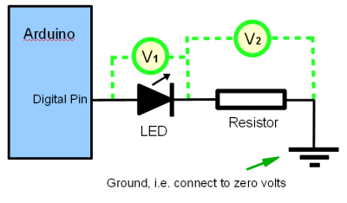
Precautions – loads
40ma per pin, total up to 200ma
Be Nice to your Arduino – divide the above by 2… or 4
For a LED, use 100 Ohm or larger resistor in series
No recent (well over 2 years now) Arduino has a built-in resistor on Pin 13.
Google “Arduino pin current”

Slide 15
Precautions
A must read:
Google “10 Ways to Destroy An Arduino”

Slide 16
Tools –

Slide 17
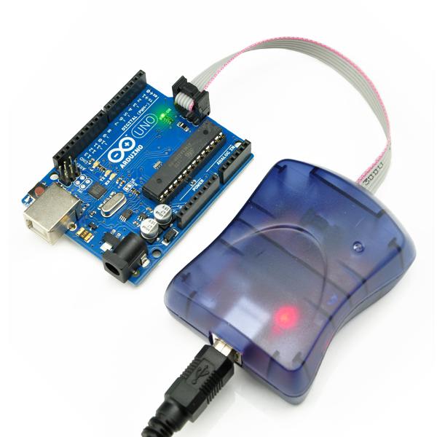
Tools – ICSP programmer
download bootloader to EEPROM
debug using Eclipse and other tools
Google:
“arduino icsp debugging”

Slide 18
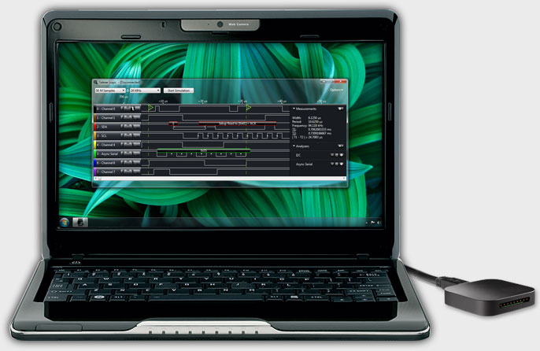
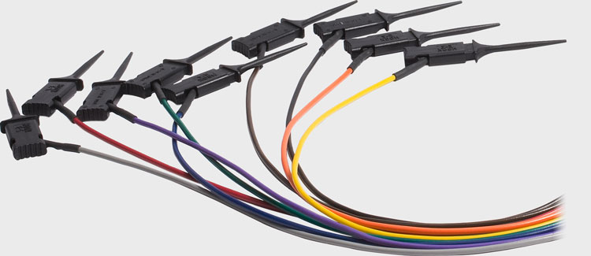
Tools: Logic Analyzer
saleae.com
Designed & Manufactured in beautiful San Francisco

Slide 19
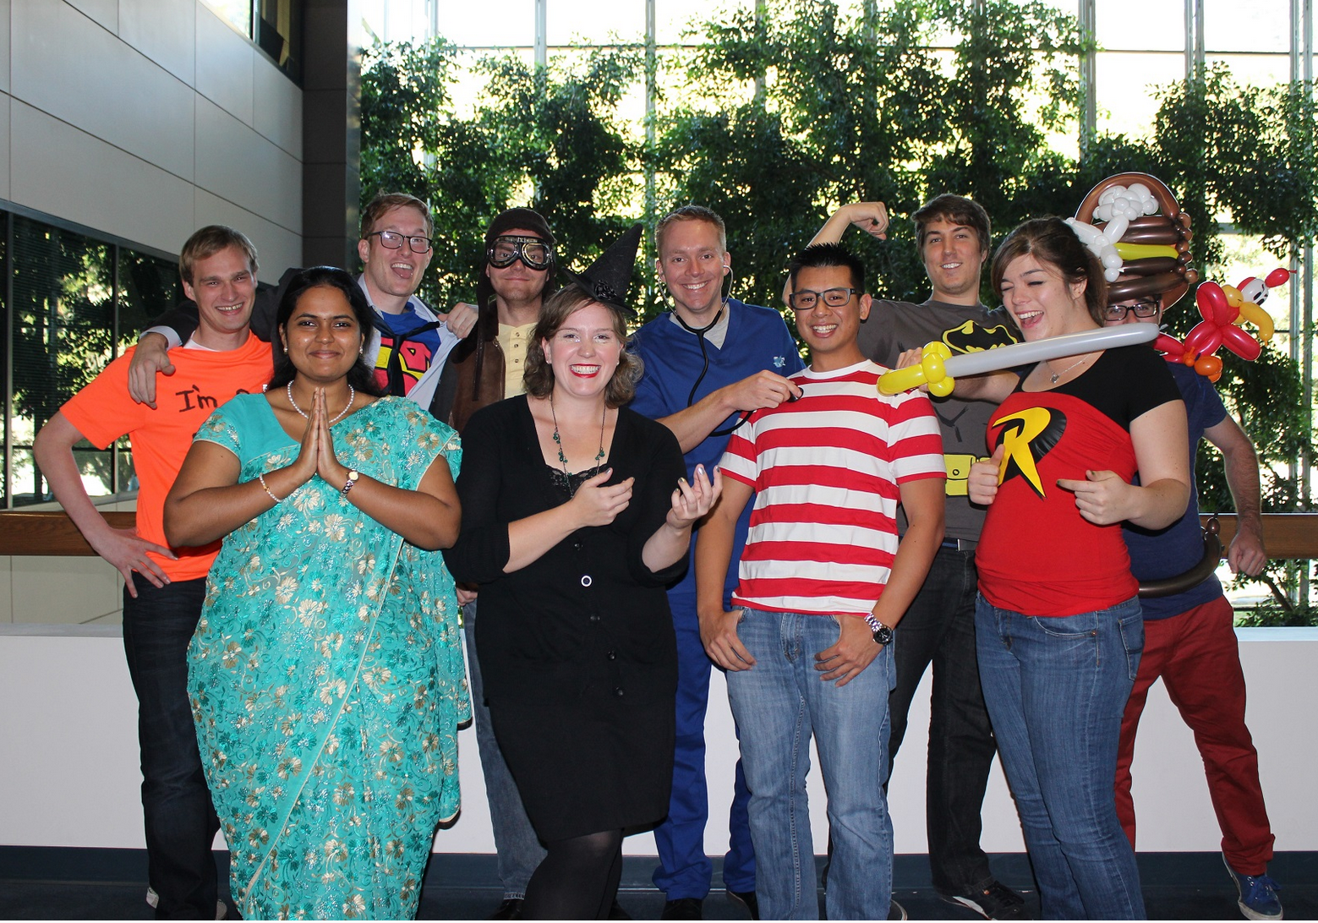
saleae.com Designed & Manufactured in beautiful San Francisco

Slide 20
Arduino in Robot Architecture
Not much power – 16 MHz crystal, close to 16 MIPS
8-bit AVR instruction set
Uno / ATmega328
Flash Memory: 32 KB of which 0.5 KB used by bootloader
SRAM: 2 KB (a.k.a. RAM)
EEPROM: 1 KB (persistent storage for settings)
Mega:
Flash Memory: 256 KB of which 8 KB used by bootloader
SRAM: 8 KB
EEPROM: 4 KB

Slide 21
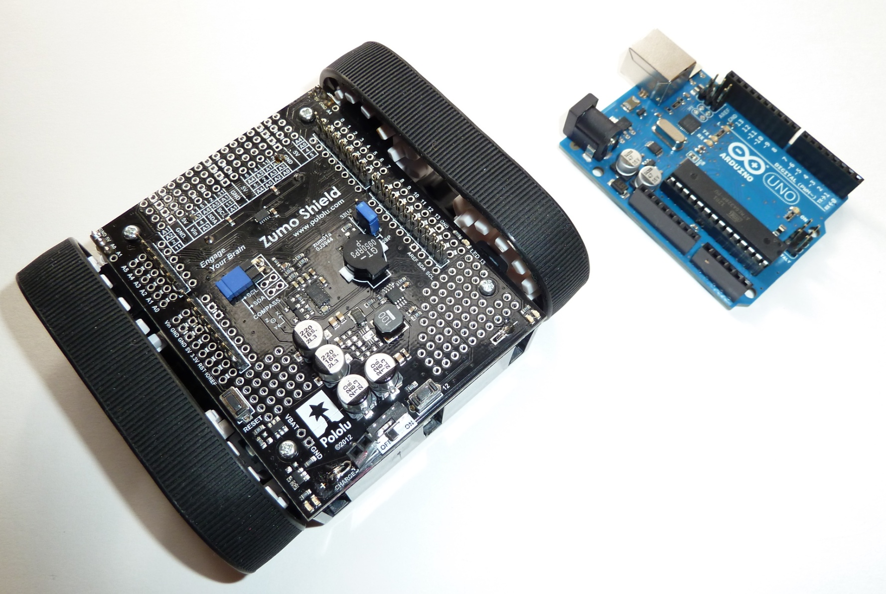
Roles
Single controller for a small robot

Slide 22
Roles
Functional controller – servo, drive, sensors, lights, animation, display
High Level Controller (PC, Beaglebone, Android)
USB to Serial
Sensor Controller
Tank Drive Controller
Arm Controller
Head Animation Controller

Slide 23
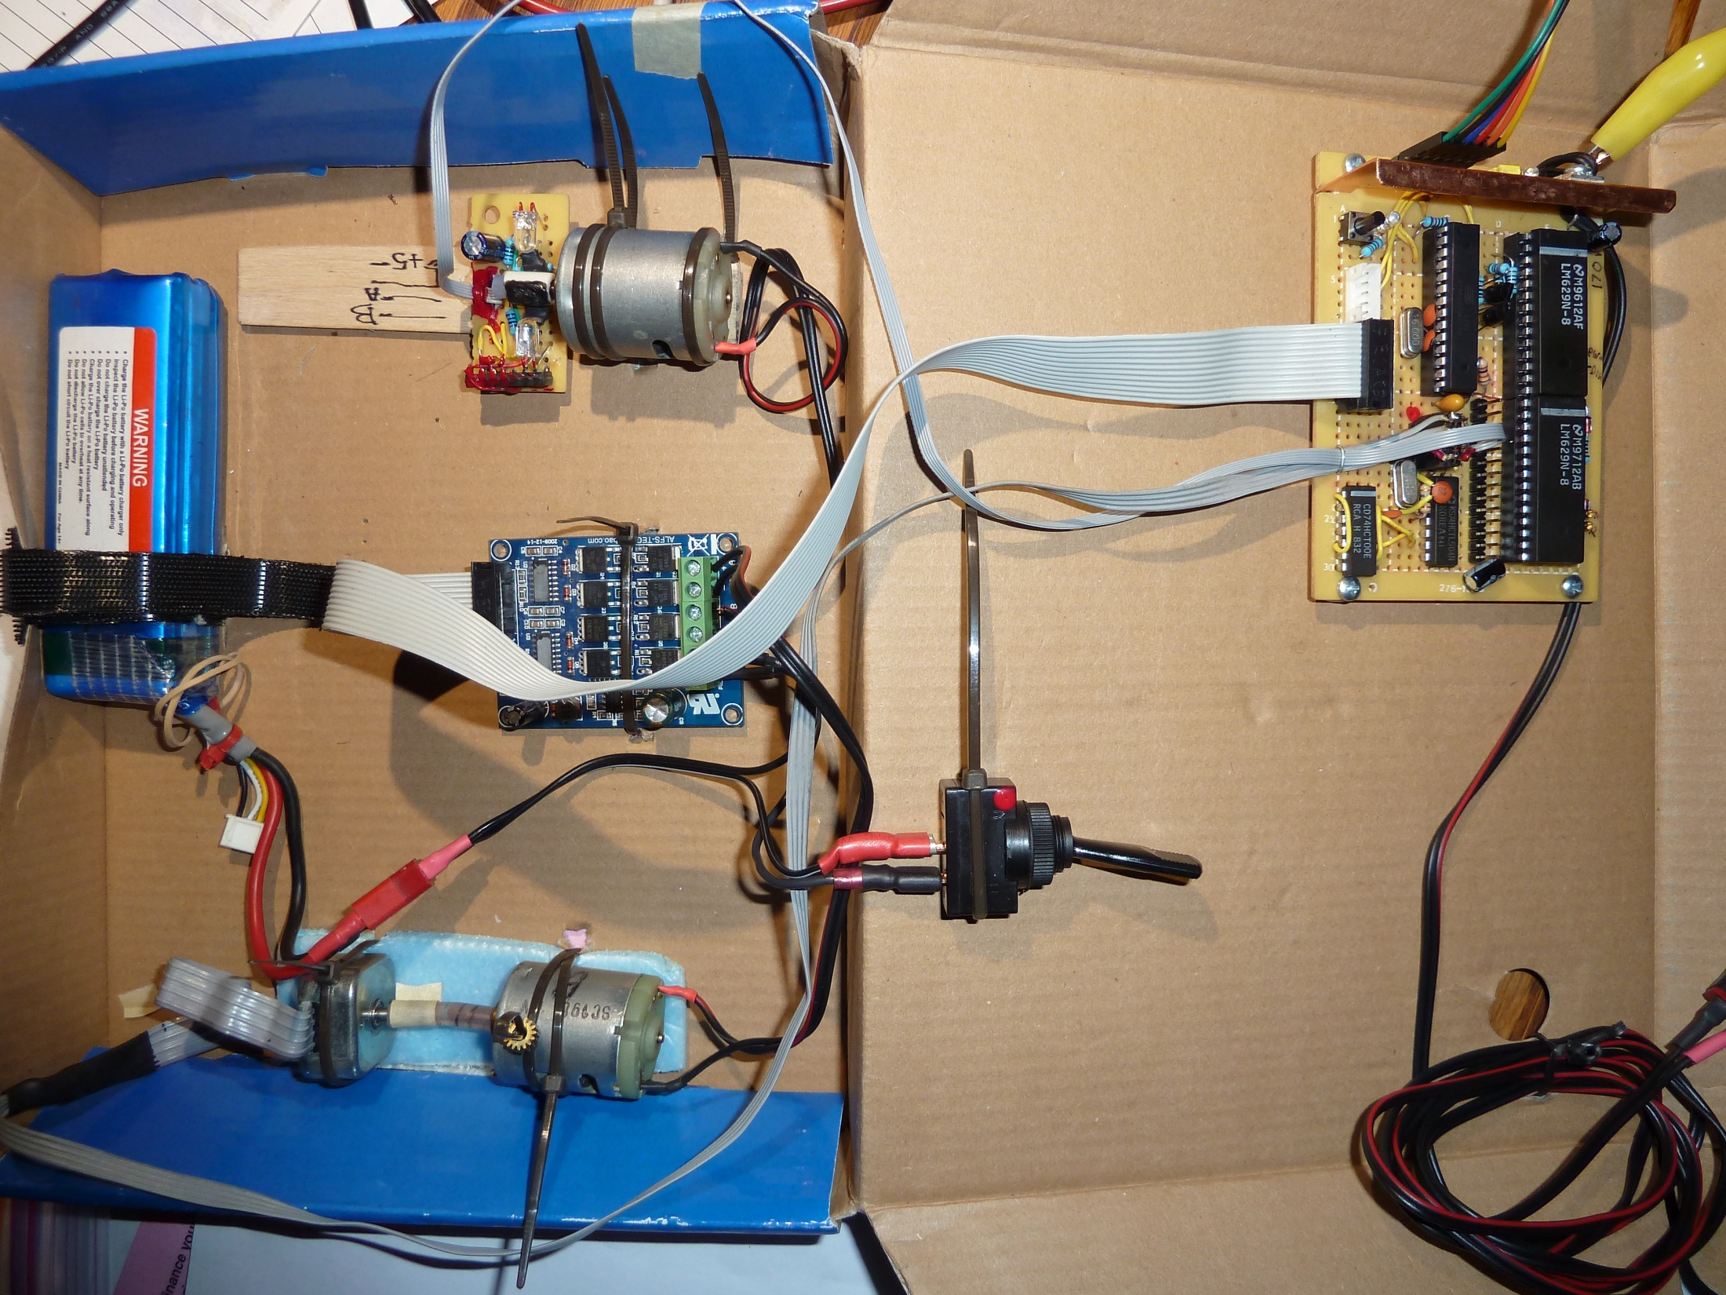

Slide 24
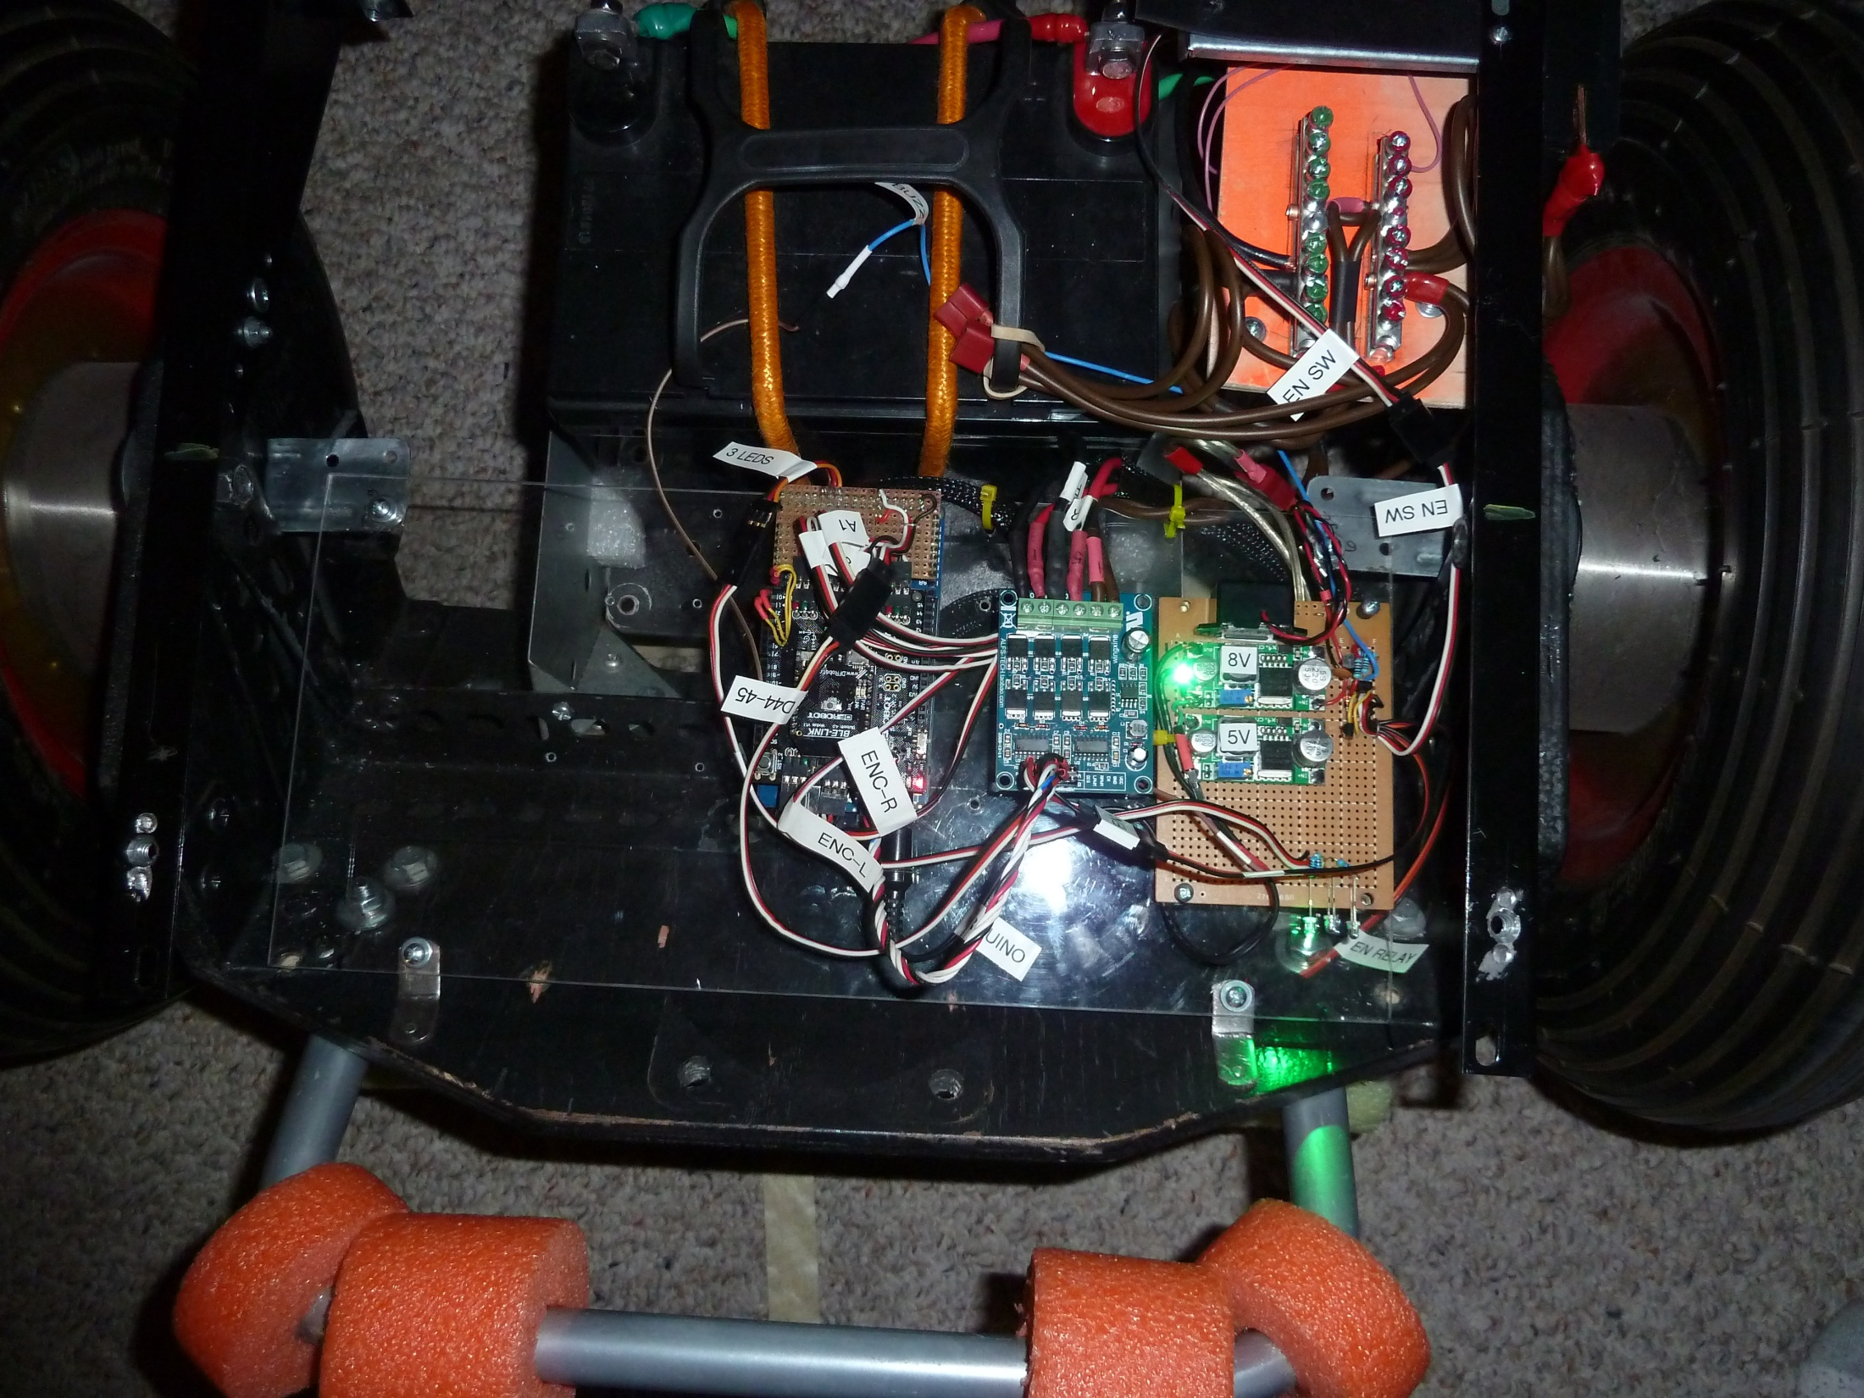

Slide 26
Role - Communication controller
High Level Controller (PC, Beaglebone, Android)
USB to Serial
Communication Controller
I2C
I2C
Sensor Controller
Tank Drive Controller
Arm Controller
Head Animation Controller

Slide 27
Code tips
Not C++, Not quite Java – but close
Google “arduino reference”
Functions - http://arduino.cc/en/Reference/HomePage
http://arduino-info.wikispaces.com/HOME

Slide 28
Code tour
Code:
Highlights of functions
Making a library
Using interrupts to read encoders
Serial communication to a PC
Driving a motor via an H-Bridge
Multitasking
I2C communication

Slide 29
Making a Library
Explore existing
Think of a good interface
Make your own

Slide 30
Arduino for Robots
Seminars at RSSC.org
Sergei Grichine
slg@quakemap.com

